Slide 1
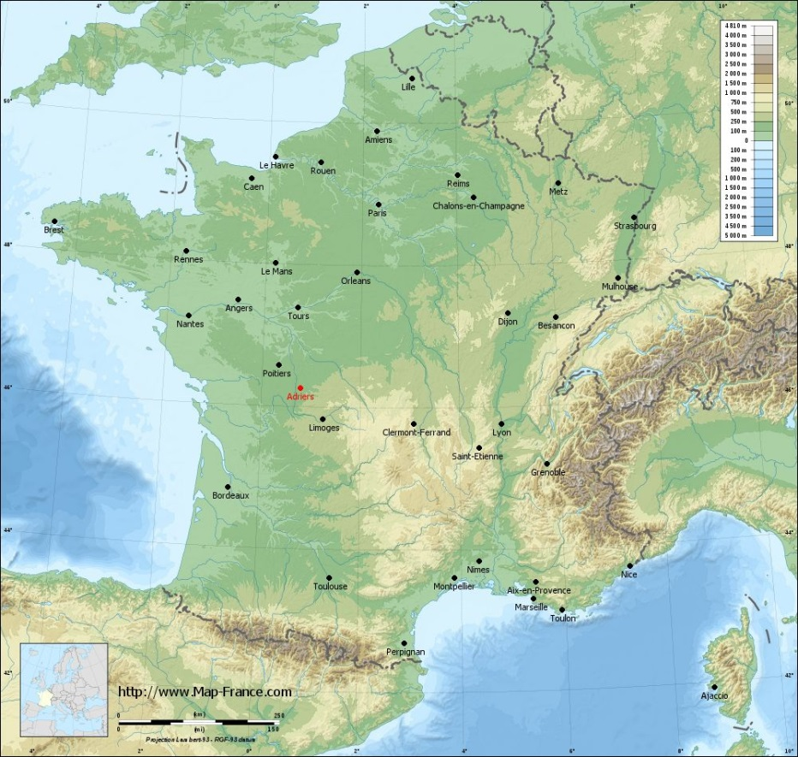
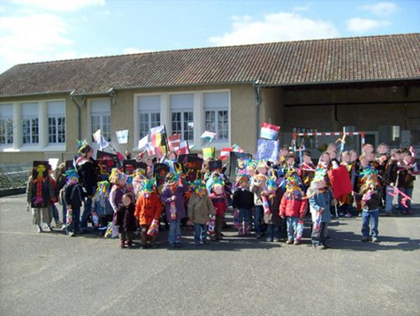
Our link with Ecole François Albert, Adriers
Year 4 are exchanging postcards and questions with our link school in Adriers, France.
In both schools the children have some preconceived ideas about each others’ culture. We are hoping to find out more by exchanging questions and answers!

Slide 2
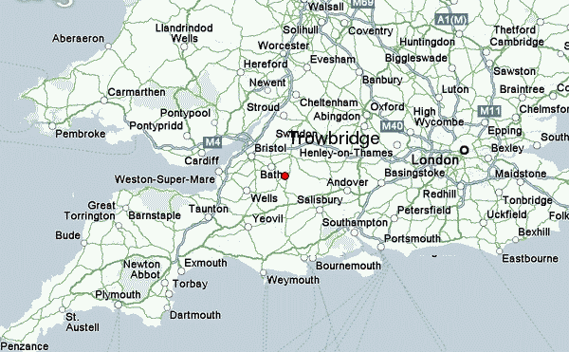
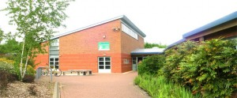
We said hello from England.
This is what we sent before Christmas….
We are the Year 4 FOXES and CRICKETS from the Mead School in Hilperton.
We are looking forward to linking up with you.
Our school is on the edge of Trowbridge (the red dot near Bath on the map below.)

Slide 3
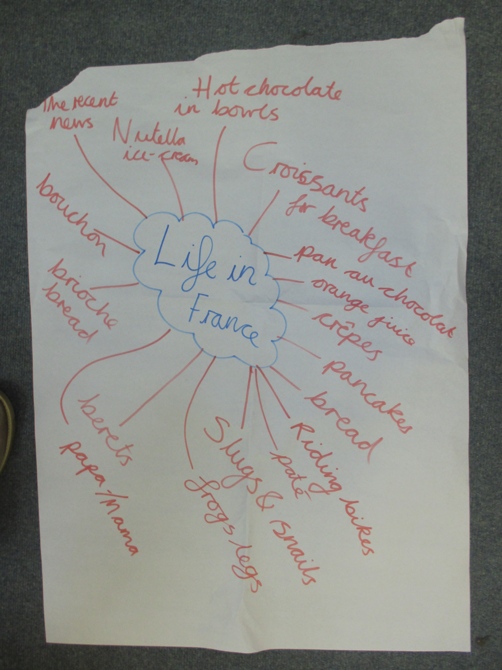
We thought about what life was like in France and we had a few ideas.
Some of the children thought that
In France people eat croissants for breakfast.
People eat crepes, French bread and pate.
Some children wondered if French people eat snails and frogs legs.
People wear berets.
People drink hot chocolate in bowls and orange juice.
They wondered if people are sad after the recent terrorist attacks.
Are we right about any of these thoughts?

Slide 4
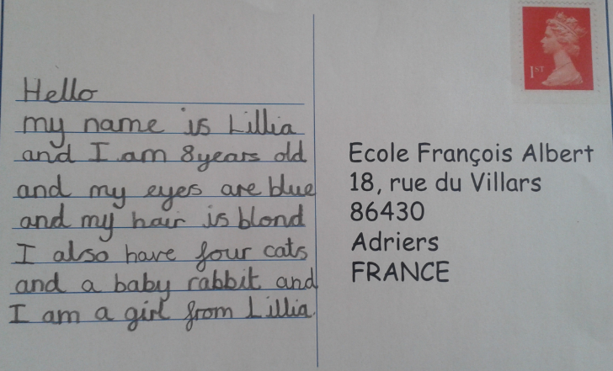
We are sending you some postcards to tell you a little about us!
Look out for them in the post!
We would love some from you too ☺

Slide 5
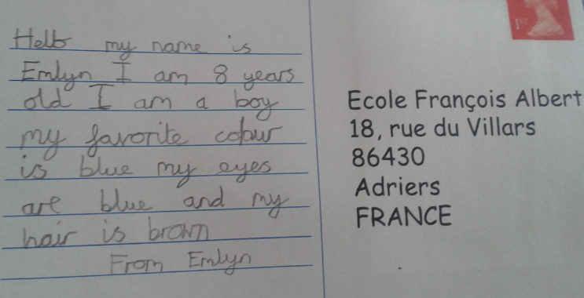
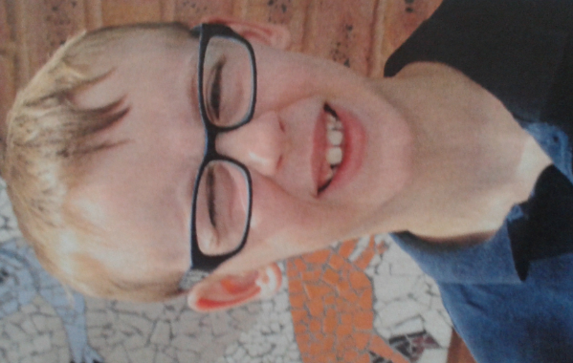
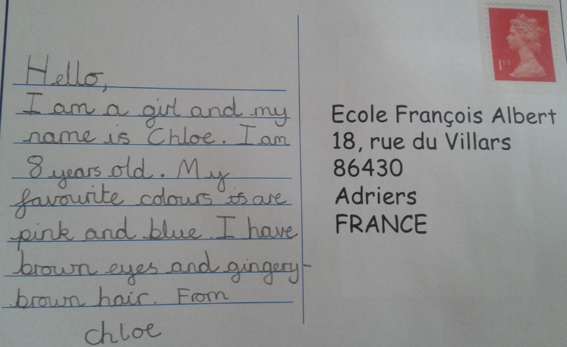
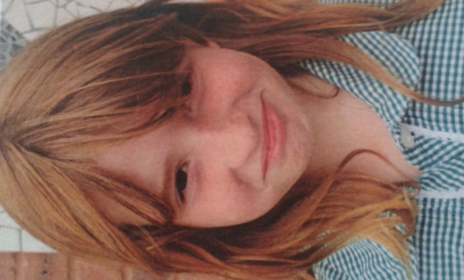

Slide 6
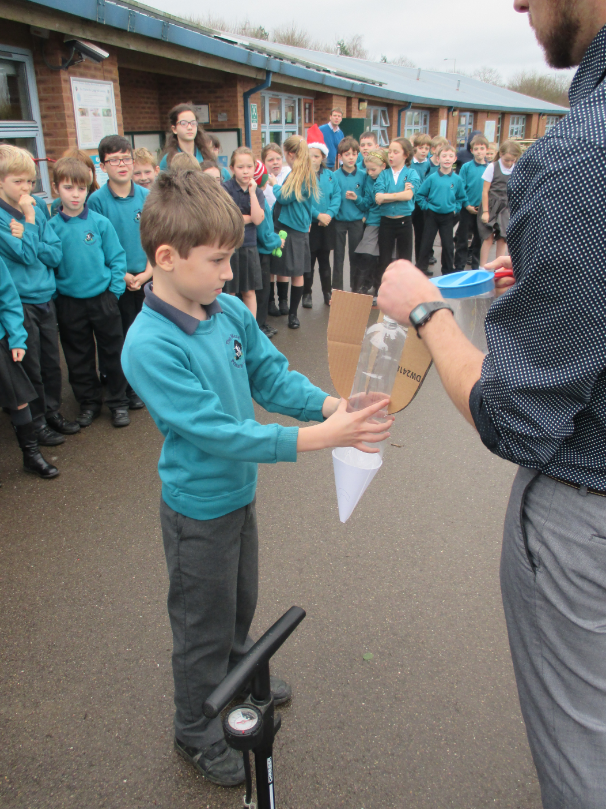
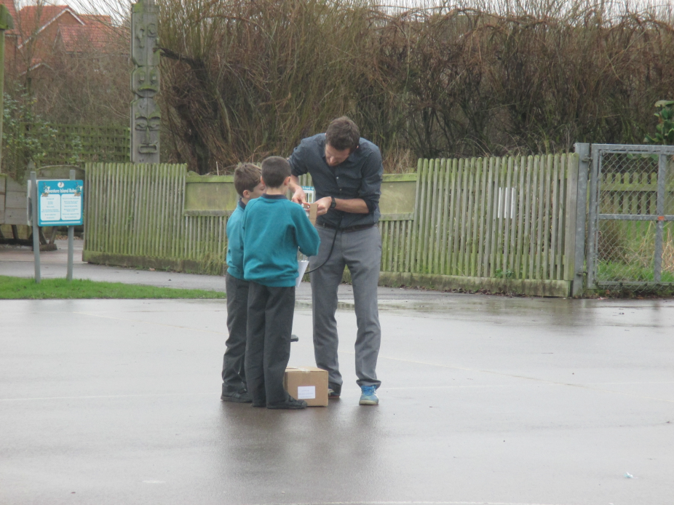
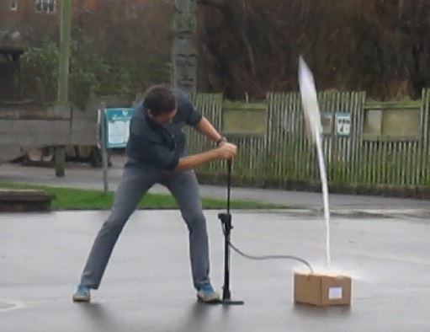
This is us making a home made rocket in science!

Slide 7
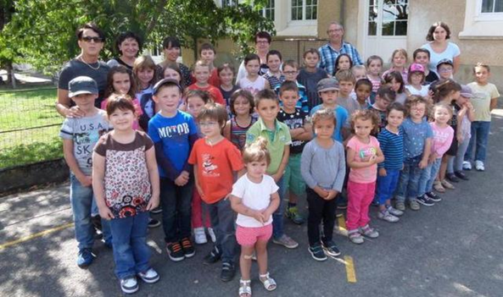
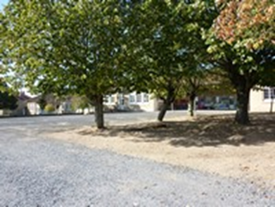
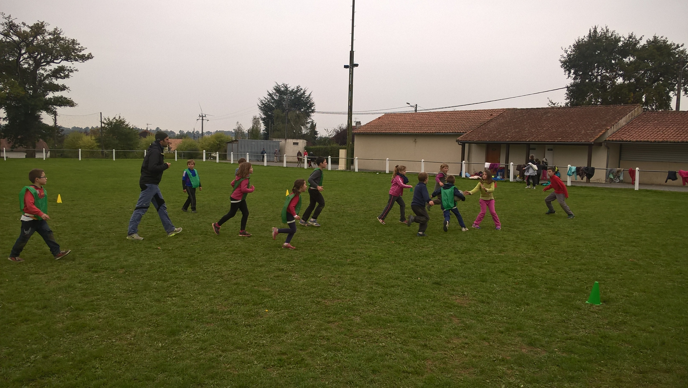
The children wrote back to us, telling us about their school.
La cour de récréation
The playground
Les élèves des 2 classes
The pupils from the 2 classes

Slide 8
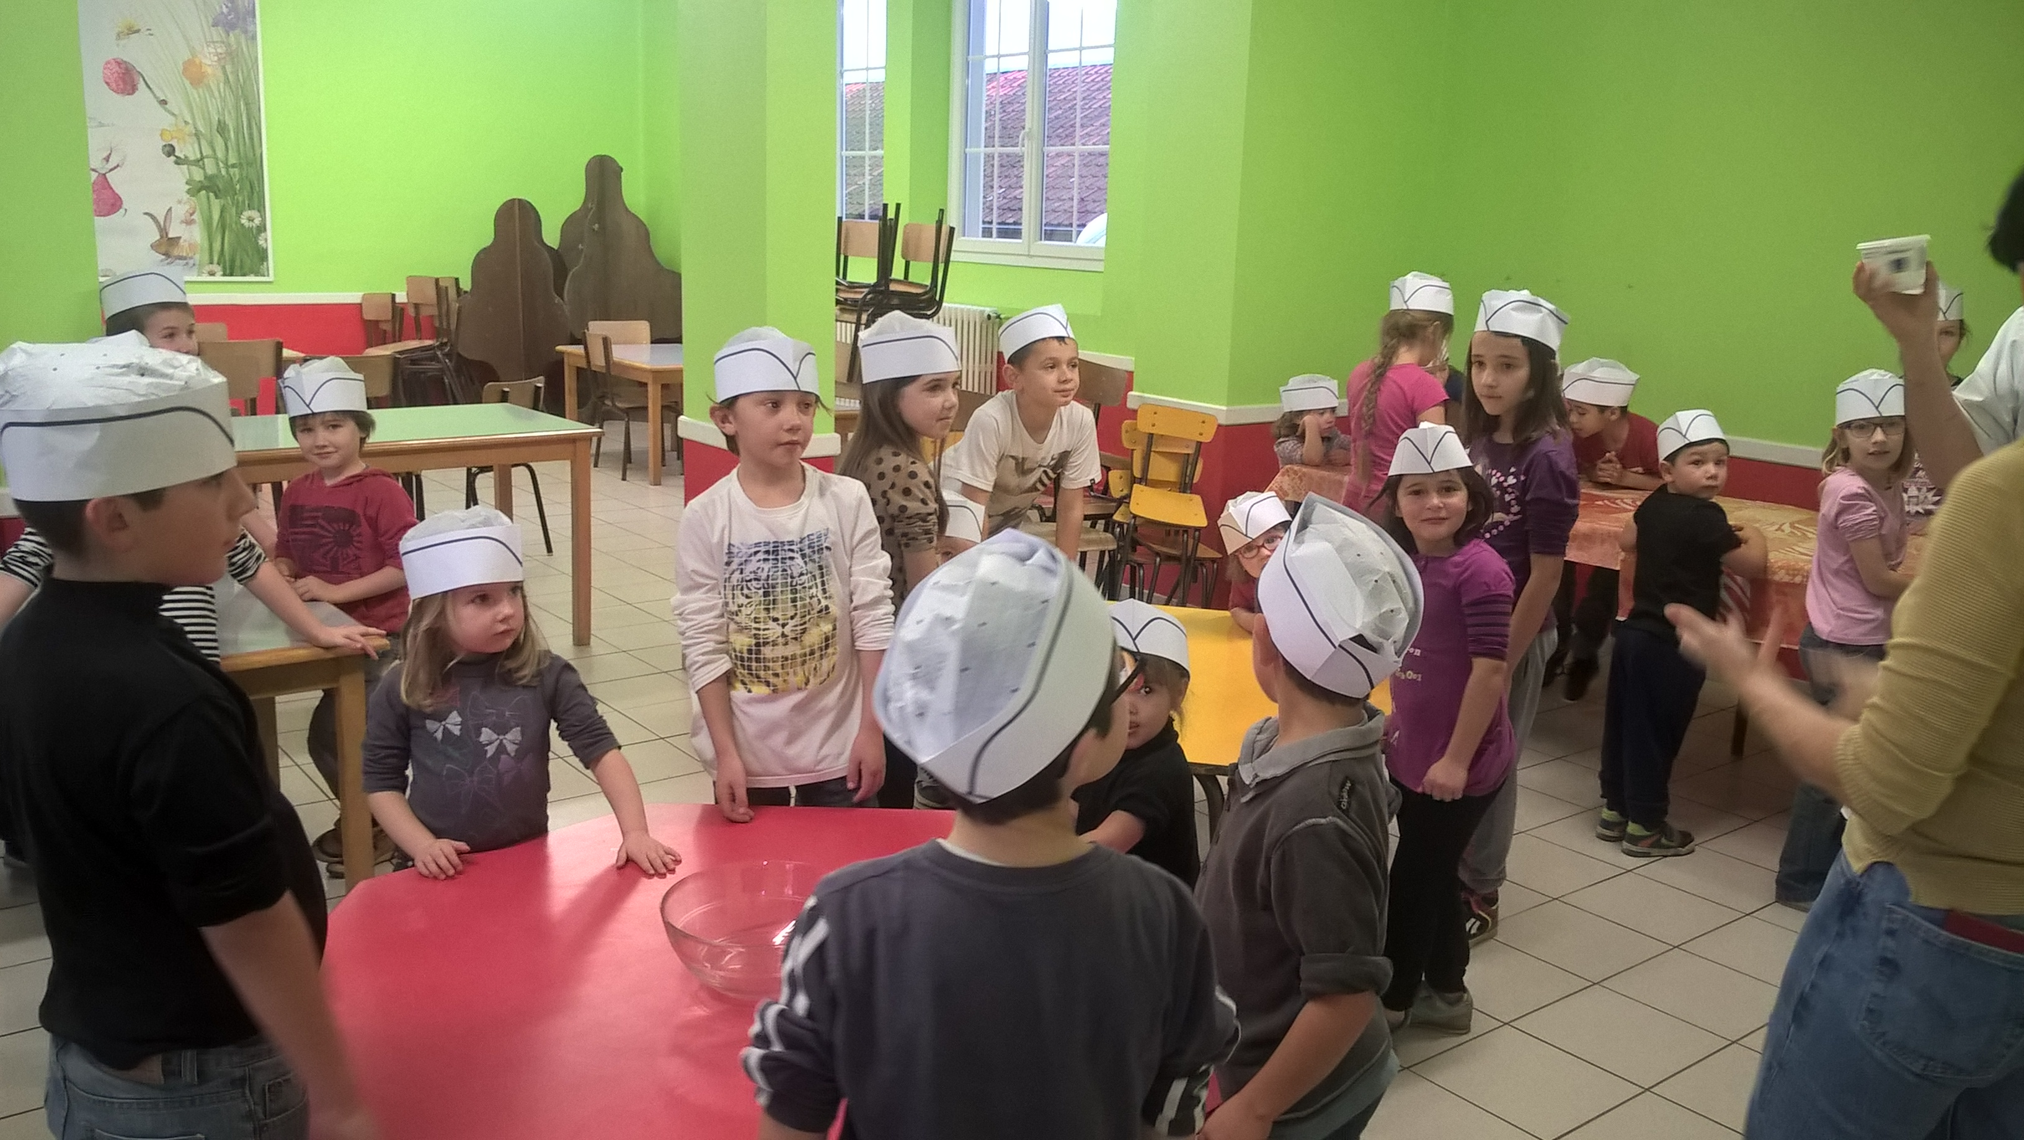
Préparation du repas de midi
Preparing lunch ☺

Slide 9
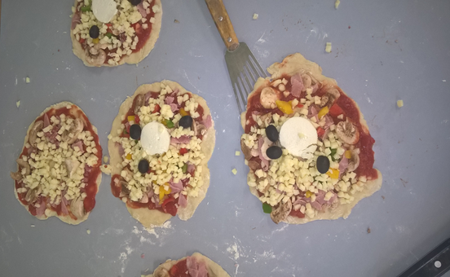
Nos pizzas

Slide 10
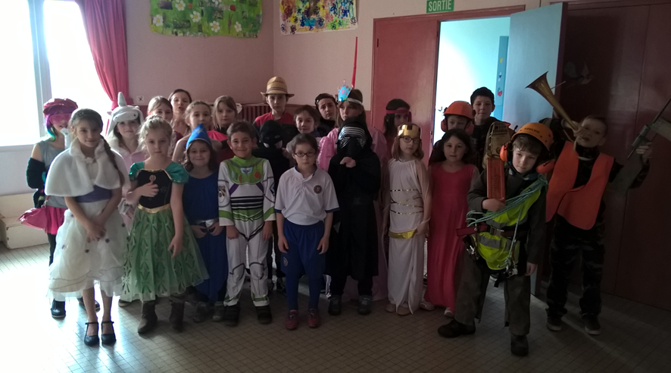
Le carnaval

Slide 11
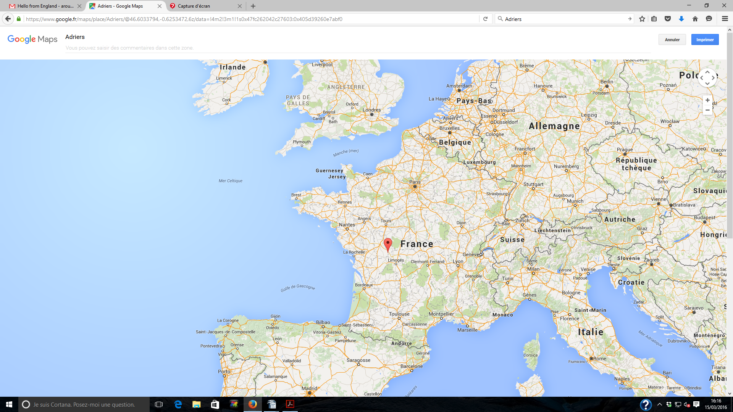

Slide 13
We were excited when the children wrote back to us, and answered our questions. They had some for us too!
Yes, we eat croissants at breakfast, and we drink hot chocolate and orange juice.
Yes, we really like crepes, bread and pates.
Yes, we eat frogs legs and snails. In Adriers we even have a place where snails are grown to eat.
No, we don’t wear berets apart from a few grandfathers.
Yes, we were sad after the terrorism but we’re not too worried.

Slide 14
The questions for us……
Do you eat bacon ?
Is England a rainy country ?
Do you play bagpipes ?
Do you study French at school ?
Are you happy to have a Queen ?
Do you wear a uniform at school ?
Do you drink tea ?
Have you got double decker buses ?

Slide 15
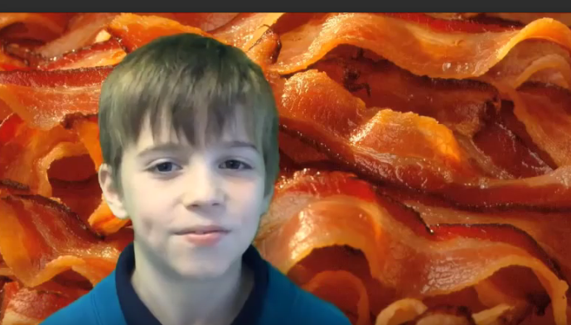
We enjoyed answering their questions. Click the link to find out what we said!
https://drive.google.com/file/d/0B0mrqvidpFJAV3pSdUZNeTFSSms/view?usp=sharing
“Yes, it’s very delicious and it’s specially for breakfast.”
Do you eat bacon?

Slide 16
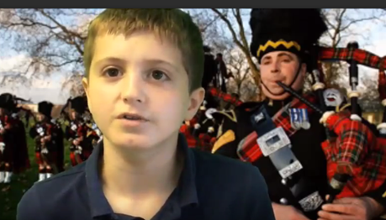
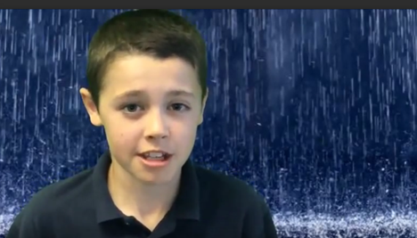
I don’t play the bagpipes, instead I play the ukelele. But some people in Scotland do play the bagpipes.
Do you play the bagpipes?
England is rainy but also very sunny at times.
Is England a rainy country?

Slide 17
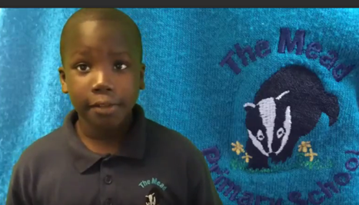
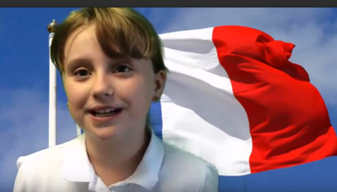

We wear uniforms and the colour is blue and it’s got badger too.
Do you wear school uniform?
Bonjour! Yes we do study French!
Do you study French at school?

Slide 18
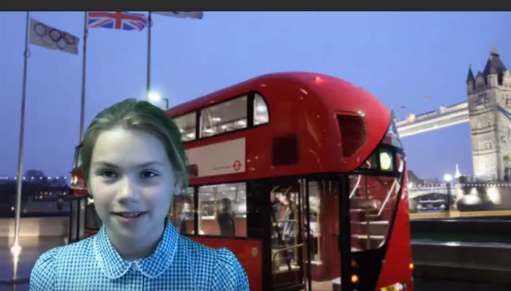
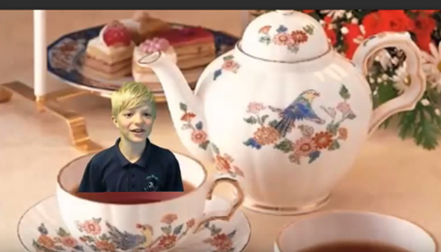
We do have double decker buses and I like being at the top!
Do you have double decker buses?
Yes we drink tea. I have milk, no sugar!
Do you drink tea?

Slide 19
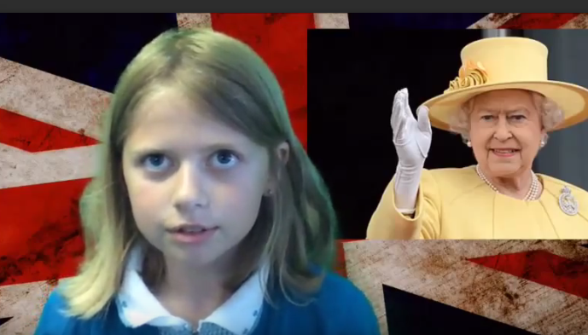
We like to have a queen because she gives people a 100 birthday cards, for when they’re 100.

Slide 20
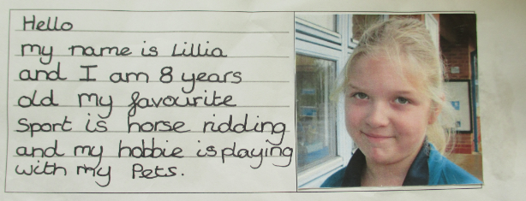
We sent the children some information about our favourite sports and hobbies.
We are waiting to hear whether they like similar things to us!
Here are a few of our new postcards.

Slide 21
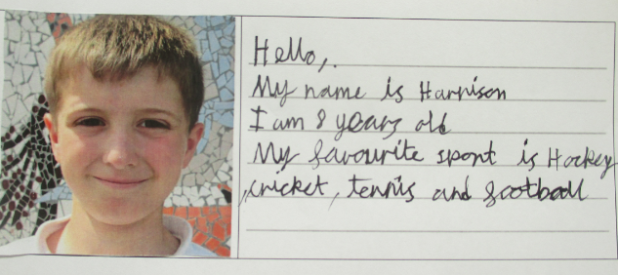
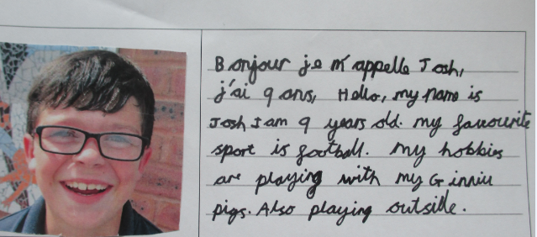

Slide 22
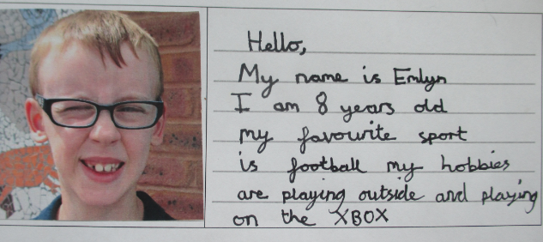
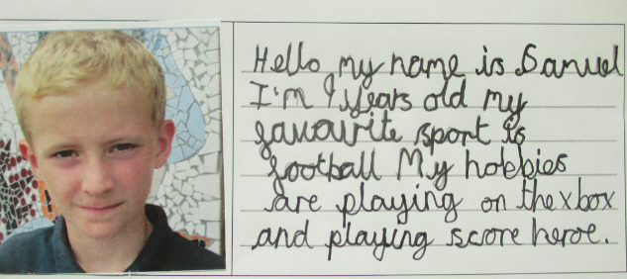

Slide 23
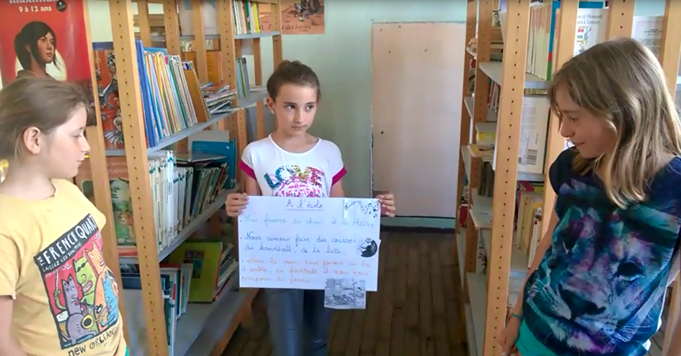
The children sent back some information about their favourite hobbies. They made posters and videos. We are just looking at these now. ☺
Here are some photos of the video clips they sent. It was great hearing the children speak French and their posters helped us with the words.

Slide 24
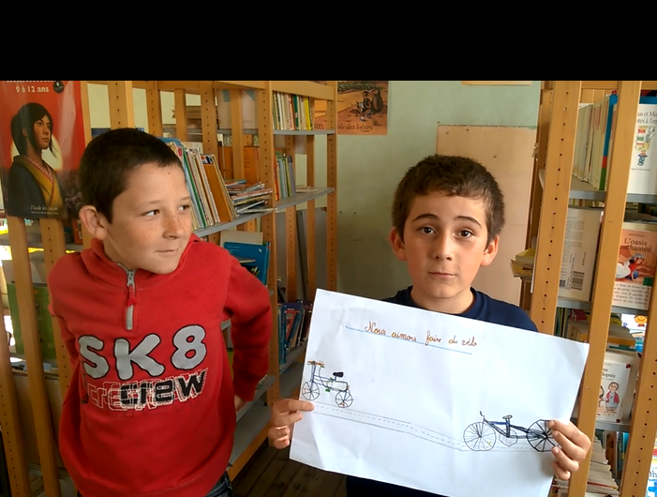

Slide 25
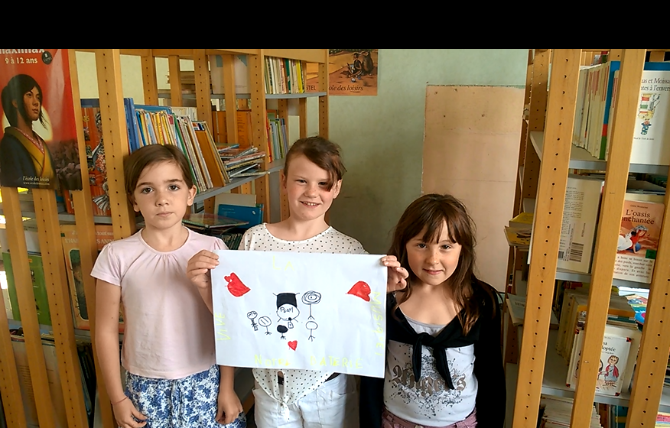

Slide 26
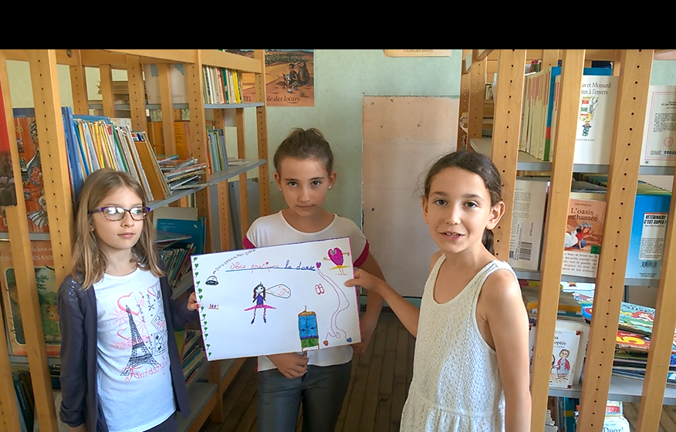

Slide 27
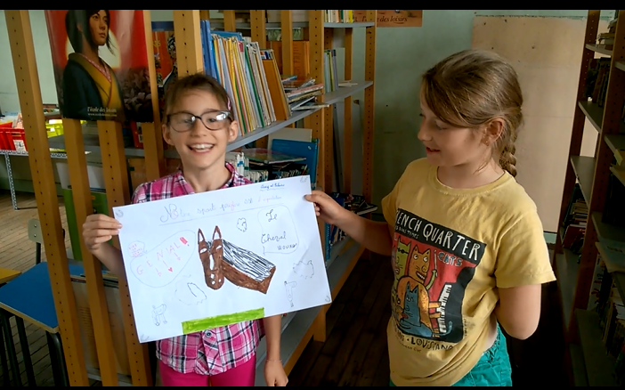

Slide 28
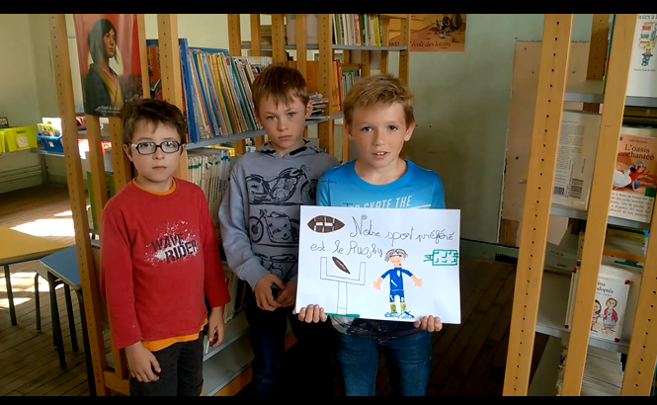

Slide 29
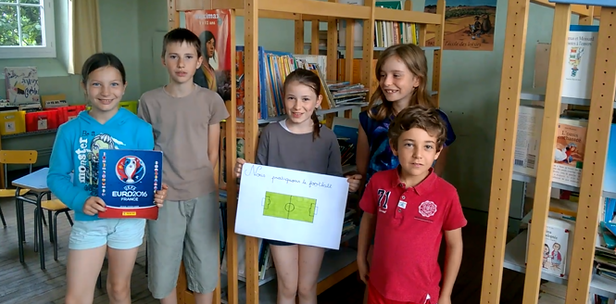

Slide 30
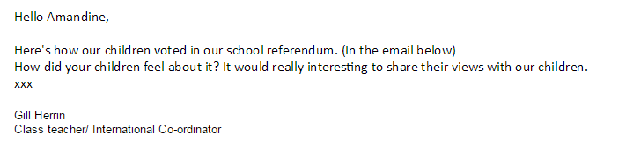
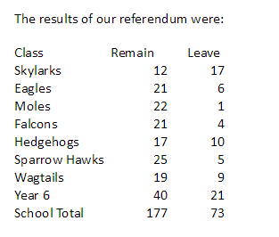
We sent information about how our classes had voted in the referendum.
Amandine replied that one little boy was “shocked, because he knew that EU was built after World War 2 to make peace between the countries so he asked if it means that the UK will not help us if there is a war.”

